Slide 1

INDIA SPACE LAB
Heat Wave Response, Recovery, Future
Challenges, and the Role of Technology
A Ground-Level Assessment and Preparedness Study (New Delhi NCR Focus)
RESEARCHER
INSTITUTION
ROLL NUMBER
DATE SPAN
Srinjoy Sil
MCKV Institute
11600223119
June 17 – July 31, 2026
Disasters Management Project: on Heat
Wave
Slide 1 of
12

Slide 2

INDIA SPACE LAB
Meteorological Baselines
Defining Extreme Thermal Events
≥40°C
The India Meteorological Department (IMD) officially declares a heat wave when
plains cross 40°C and hilly areas cross 30°C. Driven by accelerating global
greenhouse emissions and high-albedo urban development, these hazards have
shifted from rare seasonal anomalies into intense annual disasters impacting
millions across the subcontinent.
PLAINS THRESHOLD
Disasters Management Project: on Heat
Wave
Slide 2 of
12

Slide 3

INDIA SPACE LAB
Summer 2026 State-Wise Anomalies
Region Affected
Peak Temperature Recorded
≥ 45.0°C
Atmospheric and Localized Heat Pattern Profile
Maharashtra (Vidarbha)
New Delhi NCR
Oppressive warm nights offering zero core cooling relief for populations.
Intense concrete thermal trapping, triggering critical grid load failures.
Continuous persistent thermal spikes forcing multi-week severe warning alerts.
High heat matched with warm coastal winds; severe medical stress.
Prolonged humid heat spells; increased threat of occupational illnesses.
41.0°C – 44.0°C
Rajasthan (Desert Pockets)
Odisha (Coastal Belt)
Telangana & AP
40.0°C – 45.0°C
Multi-week humidity spell
36.0°C – 40.0°C
Disasters Management Project: on Heat
Wave
Slide 3 of
12

Slide 4

INDIA SPACE LAB
Institutional Context
National Plans
Scientific Baselines
Urban Heat Islands
The NDMA and local state frameworks translate
IMD's raw temperature indicators into color-
coded response triggers (Yellow/Orange/Red) to
mobilize healthcare and municipal divisions.
IPCC climate assessments prove that rising South
Asian carbon indexes make thermal anomalies
more frequent, longer, and more severe,
Modern architectural layouts heavily worsen heat
stress. Asphalt surfaces and high-density concrete
trap heavy solar radiation by day and slowly
discharge it overnight.
highlighting the immediate need for regional plans.
Disasters Management Project: on Heat
Wave
Slide 4 of
12

Slide 5
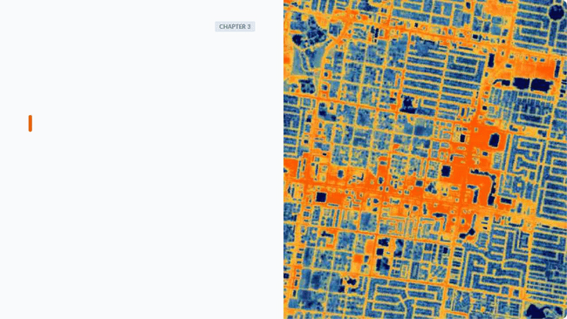
INDIA SPACE LAB
Study Focus: Delhi NCR
Target Area Vulnerability Assessment
New Delhi NCR was chosen as the primary study zone due to its extreme
continental climate. Peak temperatures hovering between 41°C and 44°C
trigger critical physiological stress.
High concrete concentrations and a dense population grid multiply the
Urban Heat Island (UHI) effect. Millions of high-risk citizens—such as
daily-wage workers, street vendors, and slum dwellers—suffer immediate
exposure without cooling resources, demanding structured protection
frameworks.
Disasters Management Project: on Heat Wave Slide 5 of 12

Slide 6

INDIA SPACE LAB
Research Methodology
Mixed-Method Strategy
High-Exposure Sampling
The research combines primary field inputs (thermometer data,
handheld GPS mapping, structured interviews, and focus group
discussions) with secondary municipal databases (IMD historical
temperature records and municipal health logs).
Targeted the unorganized unshaded labor workforce. Tracked
physiological heat strain among outdoor traffic police units, street
vendors with perishable stock, construction workers, and vulnerable
child demographics in congested slums.
Disasters Management Project: on Heat
Wave
Slide 6 of
12

Slide 7
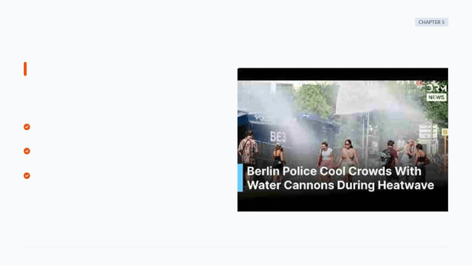
INDIA SPACE LAB
Emergency Field Response
Decentralized Warnings: Immediate deployment of multi-channel warning
networks (SMS alerts, physical vernacular flyers, radio bulletins).
Public Cool Infrastructure: Swift setup of ventilated public transit cooling
shelters and hydration booths.
Medical Support: Pre-allocating dedicated heat-stroke beds, clinical cooling
supplies, and fast emergency response ambulance networks.
Disasters Management Project: on Heat
Wave
Slide 7 of
12

Slide 8

INDIA SPACE LAB
Post-Disaster Recovery
18
Stabilizing Livelihoods & Resources
Days
Recovery goes beyond health tracking. It requires restoring agricultural networks,
managing over-extracted municipal water grids, and recovering local businesses.
This indicator highlights the uncompensated wage gap for informal workers,
emphasizing the need for targeted state compensation plans.
AVERAGE LABOR LOSS
Disasters Management Project: on Heat
Wave
Slide 8 of
12

Slide 9

INDIA SPACE LAB
Future Heat Challenges
Water Scarcity
Animal Stress
Deepening groundwater tables from rapid
reservoir evaporation and high demand.
Widespread herder losses due to cattle
dehydration and high mortality.
Grid Shocks
Labor Drops
Soaring power grids driven by extreme
Systemic losses in outdoor physical labor
hours during critical peak hours.
cooling demands, causing power overloads.
Disasters Management Project: on Heat
Wave
Slide 9 of
12

Slide 10

INDIA SPACE LAB
Technological Solutions
GIS Mapping
Predictive AI
Smart IoT
Using satellite data to identify and map
microclimatic thermal pockets and concrete
hotspots from space.
Using machine learning models to synthesize
historical climate trends and issue localized
warnings 72 hours in advance.
Installing automated weather stations and
connected sensors that log changing indices
without manual inputs.
Disasters Management Project: on Heat
Wave
Slide 10 of
12

Slide 11

INDIA SPACE LAB
Findings & Action Plan
Cool Roof Mandates: Promoting high solar-reflective index coatings on
rooftops to lower indoor heat absorption by up to 4.5°C.
Labor Realignment: Implementing statutory work bans during extreme
heat peaks to protect physical laborers from severe exposure.
Miyawaki Urban Forests: Planting dense tree buffers near transport links
to lower ambient concrete temperatures naturally.
Disasters Management Project: on Heat
Wave
Slide 11 of
12

Slide 12

Image Sources
https://cdn.prod.website-files.com/667bf07b40925e1d532db15e/66869cc7ffa82381de55886f_World-First-in-high-resolution-satellite-thermal-imaging-defines-new-era-of-climate-
monitoring.jpg
Source: www.satellitevu.com
https://i.ytimg.com/vi/bcJmfVPm4xE/sddefault.jpg
Source: www.youtube.com
https://miro.medium.com/1*mOE2a_A3qj5qZJjHg2sONw.png
Source: medium.com

Slide 13

INDIA SPACE LAB
Thank You
Preparing for a climate-resilient future.
Disasters Management Project: on Heat
Wave
Slide 12 of
12

